Slide 1
Transparency and Reproducibility in Economics: Context, and Lessons learned from 1,000 papers
Lars Vilhuber
Cornell University
J-PAL, 2022-10-25
The opinions expressed in this talk are solely the authors, and do not represent the views of the U.S. Census Bureau, the American Economic Association, or any of the funding agencies.
© Lars Vilhuber .
Notes:
I am going to
Very briefly describe the background we are coming from
Make note of the various elements of progress (and the broader picture) of open science
Describe some of the ongoing challenges
Provide some guidance based on the lessons learned in the past year

Slide 2
Context

Slide 3
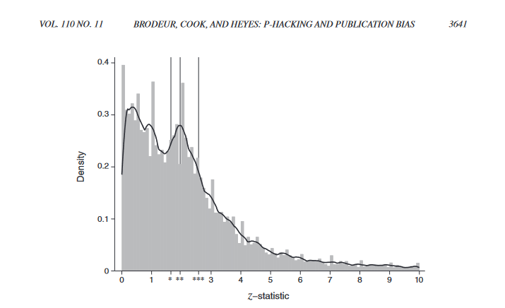
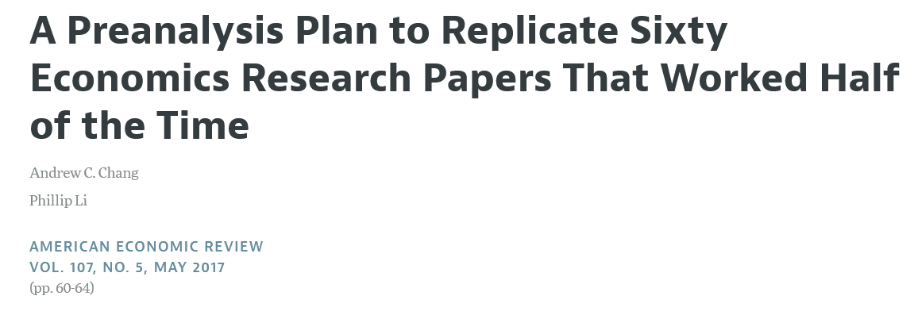


Slide 4
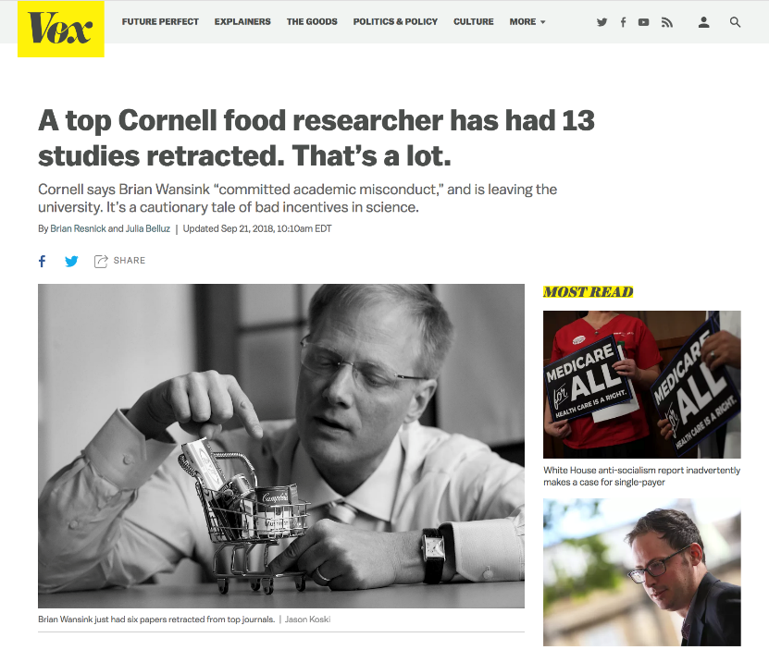
Notes:
Note on the Cornell ones – mindless eating, sizes of bowls, etc.
As of 2020 Wansink has had 18 of his research papers retracted (one twice). Seven other papers have received an expression of concern, and 15 others have been corrected.^{[8]} On September 20, 2018, Cornell determined that Wansink had committed scientific misconduct and removed him from research and teaching activities; he resigned effective June 30, 2019.^{[6]}

Slide 5
Notes:
From the retraction notice:
the first and second author provided the theoretical hypothesis; all three authors jointly designed the empirical approach and identification strategy; the third author constructed and handled the data, implemented the empirical analysis, and provided the empirical results as well as the replication data and code.
The third author states that the original data and code that produced the published results were lost.
The first and second author were not notified of the loss of the original data and code at the time it occurred and had no prior knowledge of the issues with the replication data and code provided to the journal.

Slide 6
There is a replication crisis!

Slide 7
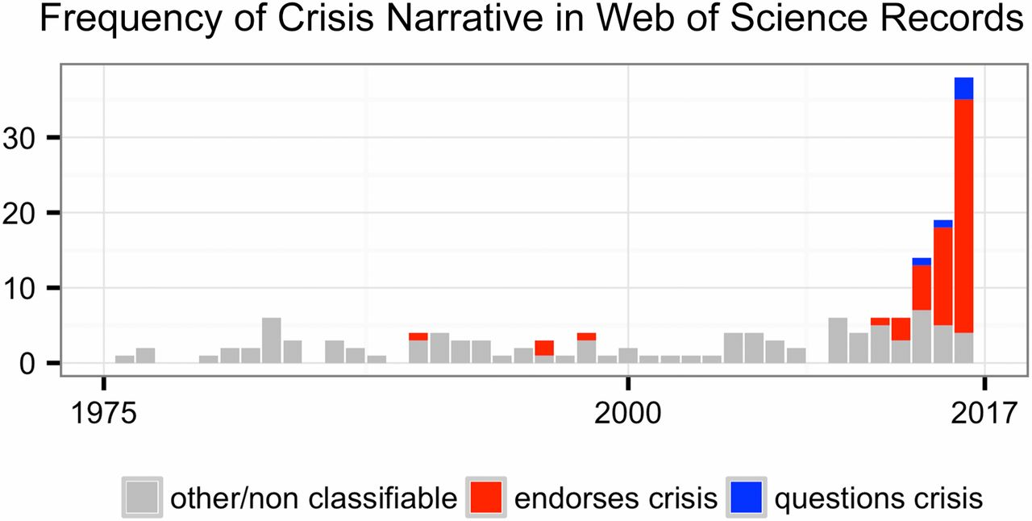
This reproducibility crisis thing….
https://doi.org/10.1073/pnas.1708272114
Notes:
Number of Web of Science records that in the title, abstract, or keywords contain one of the following phrases: “reproducibility crisis,” “scientific crisis,” “science in crisis,” “crisis in science,” “replication crisis,” “replicability crisis.” Records were classified by the author according to whether, based on title and abstracts, they implicitly or explicitly endorsed the crisis narrative described in the text (red), or alternatively questioned the existence of such a crisis (blue), or discussed “scientific crises” of other kinds or could not be classified due to insufficient information (gray).

Slide 8
The “crisis” in the 60s and 70s Sterling, 1959; Cohen, 1962; Lykken, 1968; Tukey, 1969; Greenwald, 1975; Meehl, 1978; Rosenthal, 1979
Low power
Flexibility in analysis
Selective reporting
Ignoring nulls
Lack of replication
Misuse of statistics
Source: Nosek Sackler talk 2017
Notes:
Source: Nosek, NAS.Sackler.2017.03.10
Examples from:
Button et al – Neuroscience
Ioannidis – why most results are false (Medicine)
GWAS
Biology
Two possibilities are that the percentage of positive results is inflated because negative results are much less likely to be published, and that we are pursuing our analysis freedoms to produce positive results that are not really there. These would lead to an inflation of false-positive results in the published literature.
Some evidence from bio-medical research suggests that this is occurring. Two different industrial laboratories attempted to replicate 40 or 50 basic science studies that showed positive evidence for markers for new cancer treatments or other issues in medicine. They did not select at random. Instead, they picked studies considered landmark findings. The success rates for replication were about 25% in one study and about 10% in the other. Further, some of the findings they could not replicate had spurred large literatures of hundreds of articles following up on the finding and its implications, but never having tested whether the evidence for the original finding was solid. This is a massive waste of resources.
Across the sciences, evidence like this has spurred lots of discussion and proposed actions to improve research efficiency and avoid the massive waste of resources linked to erroneous results getting in and staying in the literature, and about the culture of scientific practices that is rewarding publishing, perhaps at the expense of knowledge building. There have been a variety of suggestions for what to do. For example, the Nature article on the right suggests that publishing standards should be increased for basic science research.
[It is not in my interest to replicate – myself or others – to evaluate validity and improve precision in effect estimates (redundant). Replication is worth next to zero (Makel data on published replications; motivated to not call it replication; novelty is supreme – zero “error checking”; not in my interest to check my work, and not in your interest to check my work (let’s just each do our own thing and get rewarded for that)
Irreproducible results will get in and stay in the literature (examples from bio-med). Prinz and Begley articles (make sure to summarize accurately)
The Nature article by folks in bio-medicine is great. The solution they offer is a popular one in commentators from the other sciences -- raise publishing standards.

Slide 9
But some things HAVE changed! A bit of history…

Slide 10
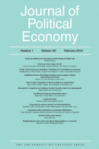
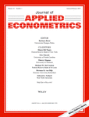


Progress
Replication archives and Data (Code) Availability policies
1985!
Notes:
Addresses availability of materials -> greater transparency

Slide 11
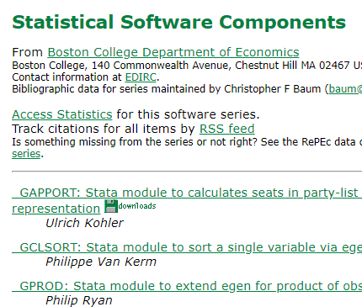

Progress
Replication archives and Data (Code) Availability policies
Shared open source software
Notes:
Shared (open source) software provides a common language, removes barriers for comparison

Slide 12

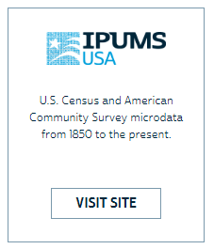




Progress
Replication archives and Data (Code) Availability policies
Shared open source software
Better public-use and shared data
Notes:
More data is becoming generally available.
US has always had a lot of public domain data
UK, Canada, India, Brazil, others increasingly make data available under liberal licenses
But also when data cannot be freely downloaded is there more sharing

Slide 13


Progress
Replication archives and Data (Code) Availability policies
Shared open source software
Better public-use and shared data
Better ways of accessing preprints/ grey literature
Working paper in Econ,
e.g. NBER (WP1)
1973!
1994!
1991!
Notes:
Greater availability of papers, early in the publication cycle (also way to “stake a claim”)

Slide 14



Progress
Replication archives and Data (Code) Availability policies
Shared open source software
Better public-use and shared data
Better ways of accessing preprints/ grey literature
Pre-registration of trials, experiments, and analyses
Notes:
Adresses the file drawer/publication bias problem

Slide 15
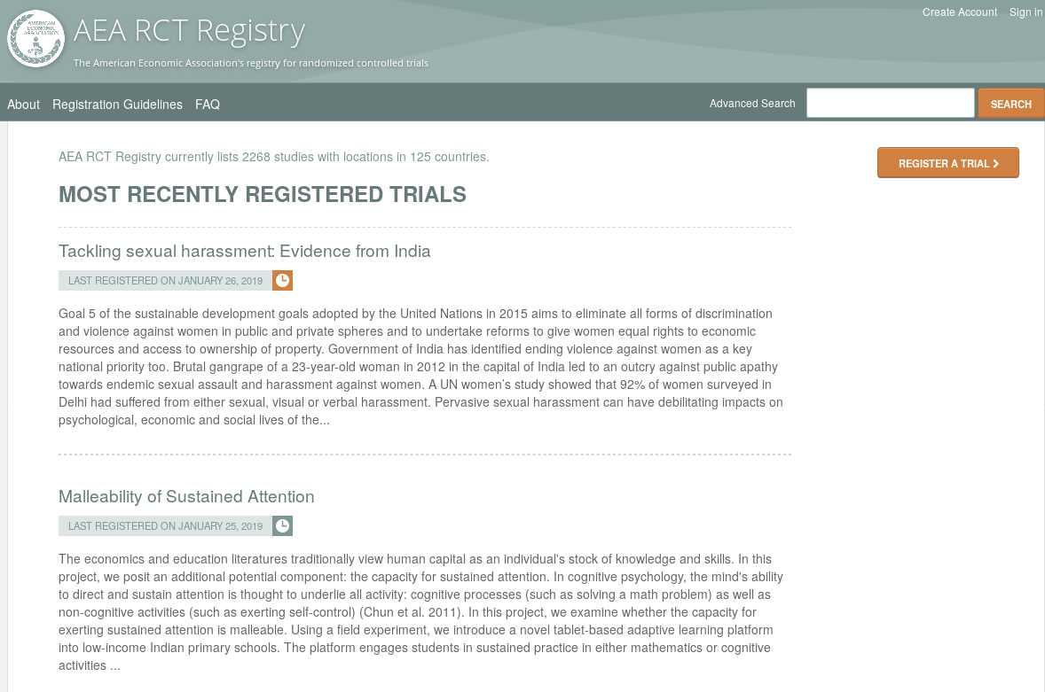
Pre-registration (2012-)
“That information is especially helpful in research that emphasizes null hypothesis significance testing.
A thorough preregistration promotes transparency and openness and protects researchers from suspicions of p-hacking.”
https://www.psychologicalscience.org/publications/psychological_science/preregistration

Slide 16
Second round (2012-)
Greater enforcement of data (and code) availability
2015, AJ Political Science
2016, Data Editor for ASA Software Section
2016, Statistical review added Science
2017: AEA appoints Data Editor, with mandate to do similar activities (also EJ, Restud)

Slide 17

Registered Reports (2014-)
https://cos.io/rr
Chambers (2014)
Nosek & Lakens (2014)
Close cousin: Results-blind review
Notes:
Addresses the publication bias problem

Slide 18


Preprints in other sciences
bioRxiv (2013)
PsyArXiv (2016)

Slide 19
Paluck (2018) https://osf.io/kvbnh/

Slide 20
So we’re good, right?

Slide 21
Hm….

Slide 22
File drawer problem and publication bias
A bias in publication: “significant” results are more “interesting”
Consequence: “Uninteresting” (unpublishable) results remain in the “file drawer”
Effect:
Inference based on multiple studies will be biased
Notes:
Suppose that you have a 100 studies of a new medicine
95 of those do not find an effect – and are not published
5 of those do find an effect – and are published
The only published results find an effect!

Slide 23
Notes:
For 25 top economics journals, 2015-2018.
Histogram of test statistics for z ∈ [0, 10]. Bins are 0.1 wide. Reference lines are displayed at the conventional two-tailed significance levels. Bottom left for top 5 journals and bottom right, non to p5
NOTE that this can detect publication bias (or p-hacking) but not tell you anything about the extent of the problem (since we don’t know the distributions of true effect sizes)

Slide 24
Proposed solution: Registries
“Registration at inception of all clinical trials in a centralized, searchable database can reduce publication bias by enabling researchers to identify all studies related to a particular intervention.” (2007) [1]
“The ICMJE member journals will require, as a condi- tion of consideration for publication, registration in a pub- lic trials registry.” (2004) [2]

Slide 25
Progress
Replication archives and Data (Code) Availability policies
Shared open source software
Better public-use and shared data
Better ways of accessing preprints/ grey literature
Pre-registration of trials, experiments, and analyses
Notes:
Adresses the file drawer/publication bias problem

Slide 26
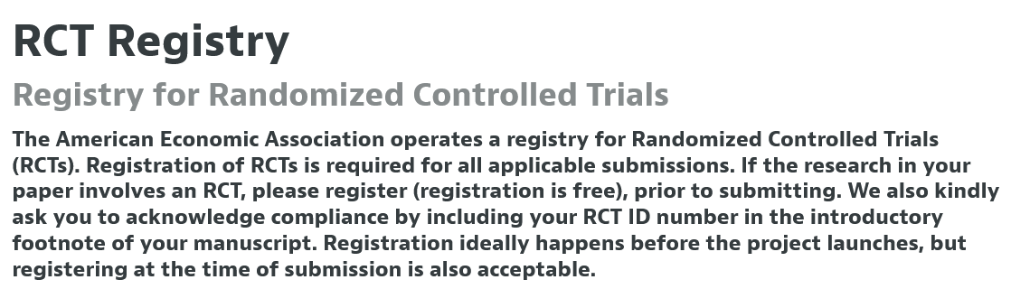
AEA Registry
https://www.aeaweb.org/journals/policies/rct-registry

Slide 27
IPA and J-PAL Registration Policy
All J-PAL/IPA funded and implemented studies are required to register studies, and pre-registration is recommended.
J-PAL Policy: https://drive.google.com/file/d/0B0jhbX9qjixBcG4wMU5jT3pLbDg/view
IPA Policy: See Research Protocols
Notes:
Goal
100 percent registration of ongoing and completed J-PAL studies
All new J-PAL registrations prior to project start date
Your roles: ensure study is registered. If you are still working on the project after it has been completed, make sure the post-trial fields are also updated

Slide 28
Registering a study
When registering a study, researchers can post:
Research hypotheses
The [type of] data used to test them
Planned research design
This has several benefits:
Fills in gaps in the literature
Facilitates comprehensive meta-analysis
Reduces risks of data-mining
Notes:
Researchers can post research hypotheses, the data used to test them, and what their planned research design is in a place where other members of the scholarly community can access that information. This generates greater accountability, as once a paper is published it is possible to check whether the researcher followed the original research plan and if not, whether she provided an explanation why
To elaborate, registry entries can serve several purposes.
Registry facilitates the discovery of published and unpublished research. If it became the norm to pre-register studies, we'd have a sense of which studies did not produce significant results or failed.
If widely used, registries can be used to track all studies in a given field. They can give an overview of the body of work on a given topic, so that others can better understand gaps in the literature or future research needs. A comprehensive registry also allows the universe of existing studies in a given discipline to be more visible and searchable.
The third clear benefit relates to reducing the risk of data mining, because we'll know what the author's original intentions were and we will be able to see if the results publish differ from the original plan. This can clarify the robustness of the results of the study. - this is where preregistration particularly impt

Slide 29
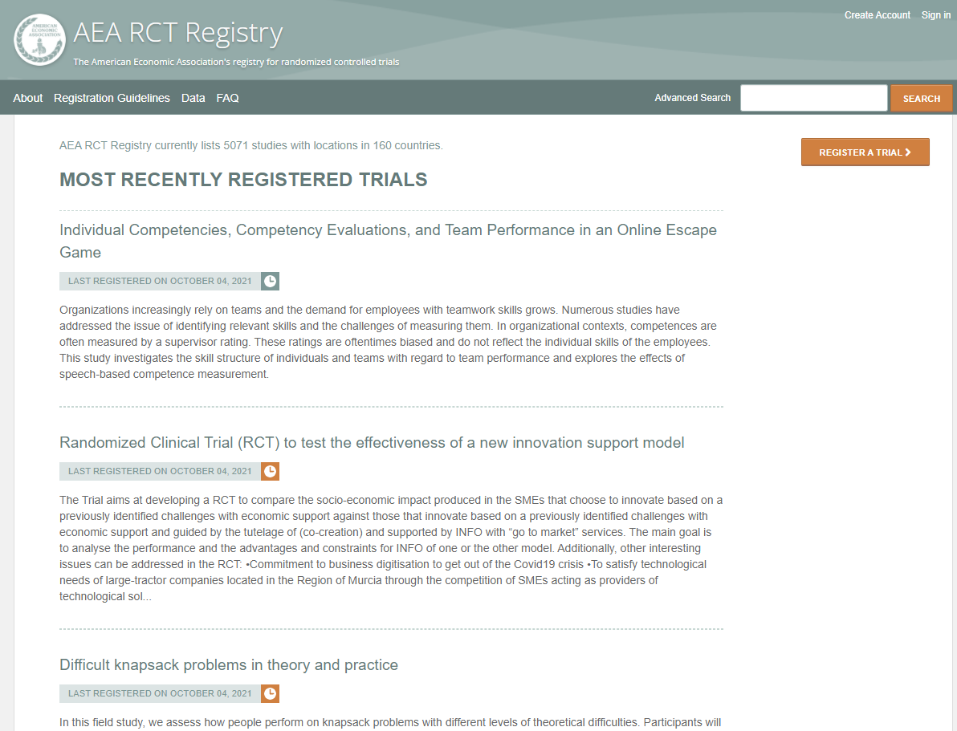
www.socialscienceregistry.org
Notes:
AEA registry is for any studies that involve an RCT, but imposes no restrictions on study location or topic matter. It was started in 2012. J-Pal supported its creation and now manages it

Slide 30
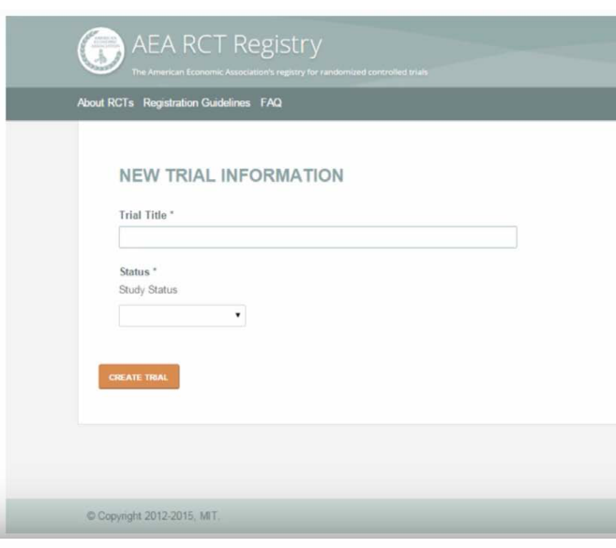
Simple Registration Process
Username/login
18 mandatory fields, including:
Title, country, status
Abstract
Trial and intervention start dates
List of main outcomes
Research design
Most information already reported to IRB
Requires PI final approval
Need help?
Stuti Goyal sgoyal@povertyactionlab.org
J-PAL Global
AEA Registry Administrator
J-PAL Research Resources
Notes:
J-PAL’s Role: Manage the website, Assist PIs with registration (all offices)
Ongoing maintenance and improvements
DOIs launched a couple of years ago. Makes registry entries on the AEA more findable, interoperable, accessible, and reusable.

Slide 31
Questions?

Slide 32
P-hacking and specification searches
Researchers might choose specifications that “make the results look better”

Slide 33
Possible solution: Pre-analysis plans
Goes beyond simply registering a trial
Describes how researchers plan to analyze the data – in the absence of the data!
Like writing a paper without the data
Where?
Same registries

Slide 34
About Pre-Analysis Plans (PAPs)
Filed publicly, typically before intervention start but at the latest before data analysis begins
Can increase credibility of findings but can involve significant effort
Not done for all projects
Important to read through a PAP if one was done on your project
J-PAL and IPA do not require pre-analysis plans
HOWEVER: some individual J-PAL initiatives do require them (specifically initiatives at J-PAL North America)
Notes:
The idea of PAPs is to basically outline, in advance, what are the key variables you're going to look at and how you're going to run the analysis. PAPs are distinct from the concept of pre-registration, which in a less detailed exercise.
A pre-analysis plan (PAP) is filed publicly, typically before intervention start but at the latest before data analysis begins, and describes how the researchers plan to conduct the study and analyze the resulting data. Since the PAP needs a time stamp, it is usually filed with the trial registration for the study. It can be filed at the time of registration or added later.
PAPs can increase the credibility of the findings and address concerns of specification searching by outlining the expected analysis approach ex ante. This can be particularly useful for decisions with a lot of researcher discretion, such as when primary outcomes could be measured in many different ways or when analyzing treatment effects on specific sub-groups of the population. PAPs can also be useful when a party to the evaluation has a vested interest in the outcome. (Banerjee et al. 2020)
However, the benefits of a detailed PAP also come with costs (Olken 2015), not least because writing such a PAP can take considerable time and effort (Ofosu & Posner 2019).

Slide 35
Content of a PAP (Olken 2015)
Designate and define primary outcome variable, co-primary outcome variables, or index variable.
(designate and define secondary outcome variables, if necessary)
Specify rules for including/excluding data or observations
Identify specific regression specification and statistical tests to be used
State any planned sub-group analysis
Common Problems: Not enough information vs. too little information
J-PAL Research Resources
Notes:
Primary outcomes: The primary outcome variable is what is the key variable or variables that you're going to use to determine what the impact of your study was. So if it's an evaluation of some program, what's the key measure that you're going to look at to say, was this program successful or not?
The level of specificity you should be looking for is: if a different researcher picked up your pre-analysis plan, tried to code up that variable from your data, would they get the same variable or not?
Secondary outcomes: Secondary outcome variables have a very precise meaning, which is there are things that can potentially be used as claims if the primary outcome variables are true. The way I would think about this in our case is secondary outcome variables are variables that you're committing in advance to look at and report in your analysis. But they are not the key primary variables you're going to use to evaluate did your study work or not.
Including/excluding data: e.g., how to deal with outliers. Will always have outliers, but there is a lot of discretion involved in data cleaning, and this is one of the subtler but probably more common areas where you see p-hacking and so where you’d want to include rules in the PAP. Problem: hard to make decisions about cleaning before seeing the data. One way to do this is to look at the data collected, without distinguishing between the different groups of the study (treatment and control), and look at the outcome variables to see what kinds of values they take.
Specifications: e.g., estimator, whether include controls, fixed effects, etc.
Subgroup analysis: looking at different groups of participants. Challenge is that there are many subgroups
Temptation to slice the data so that random chance finds an impact on a particular subgroup
Specifying subgroup analysis in advance makes the results more credible
Common Problems: Not enough information vs. too little information
Want to include issues where you have discretion but not extraneous info like lit review
“For example, if you leave out the literature review from your preregistration, will Leif now be more concerned? Of course not, as your literature review does not affect how much flexibility you have in your key analysis. If you leave out how long people spent in the lab, how many different RAs you are using, why you think your hypothesis is interesting, or the description of your exploratory analyses, will Leif be more concerned? No, because none of those things affect the fact that your analyses are confirmatory.

Slide 36
Scope of PAPs (Banerjee et al., 2020)
Impossible to specify all contingencies in a PAP
Tradeoffs to amount of time spent on PAPs
Registry entry may be sufficient for a PAP (e.g. primary outcomes, experimental design, randomization details)
PAP as a “historical record of initial thoughts and plans, rather than a binding, legal contract for what can be done and presented.”
Support publishing a populated PAP with results and a separate research paper.

Slide 37
Resources for Thinking about a Pre-Analysis Plan
Running Randomized Evaluations (Glennerster and Takavarasha 2013)
Pre-Analysis Plan Template (Ganimian 2015)
The Promises and Perils of Pre-Analysis Plans (Olken 2015)
Transparency, Reproducibility and the Credibility of Economics Research (Christensen and Miguel 2016)
In Praise of Moderation (Banerjee et al., 2020)
J-PAL Research Resources on registration and PAPs
Study Example: Casey, Glennerster, and Miguel (2012)
Notes:
YOUR role as RAs: read the PAP if there is one

Slide 38
Questions?

Slide 39
Ex-post replicability and reproducibility
Notes:
Replication is a central pillar of the scientific method: New results in the hard sciences, like physics, are not considered real results until they have been replicated in other labs

Slide 40

Replication continuum
https://doi.org/10.17226/25303
08
Reproducibility
Narrow Replication (Pesaran 2003)
Pure Replication (Hamermesh 2007)
Verification (Clemens 2015)

Slide 41
Replication continuum
Same data | Same code | Same methods | Same context
08
Reproducibility
Narrow Replication (Pesaran 2003)
Pure Replication (Hamermesh 2007)
Verification (Clemens 2015)

Slide 42
What does reproducibility buy you?
Results in the paper were actually produced by the code (as claimed)
Replication package has a complete and exhaustive description of what is needed to produce those results

Slide 43
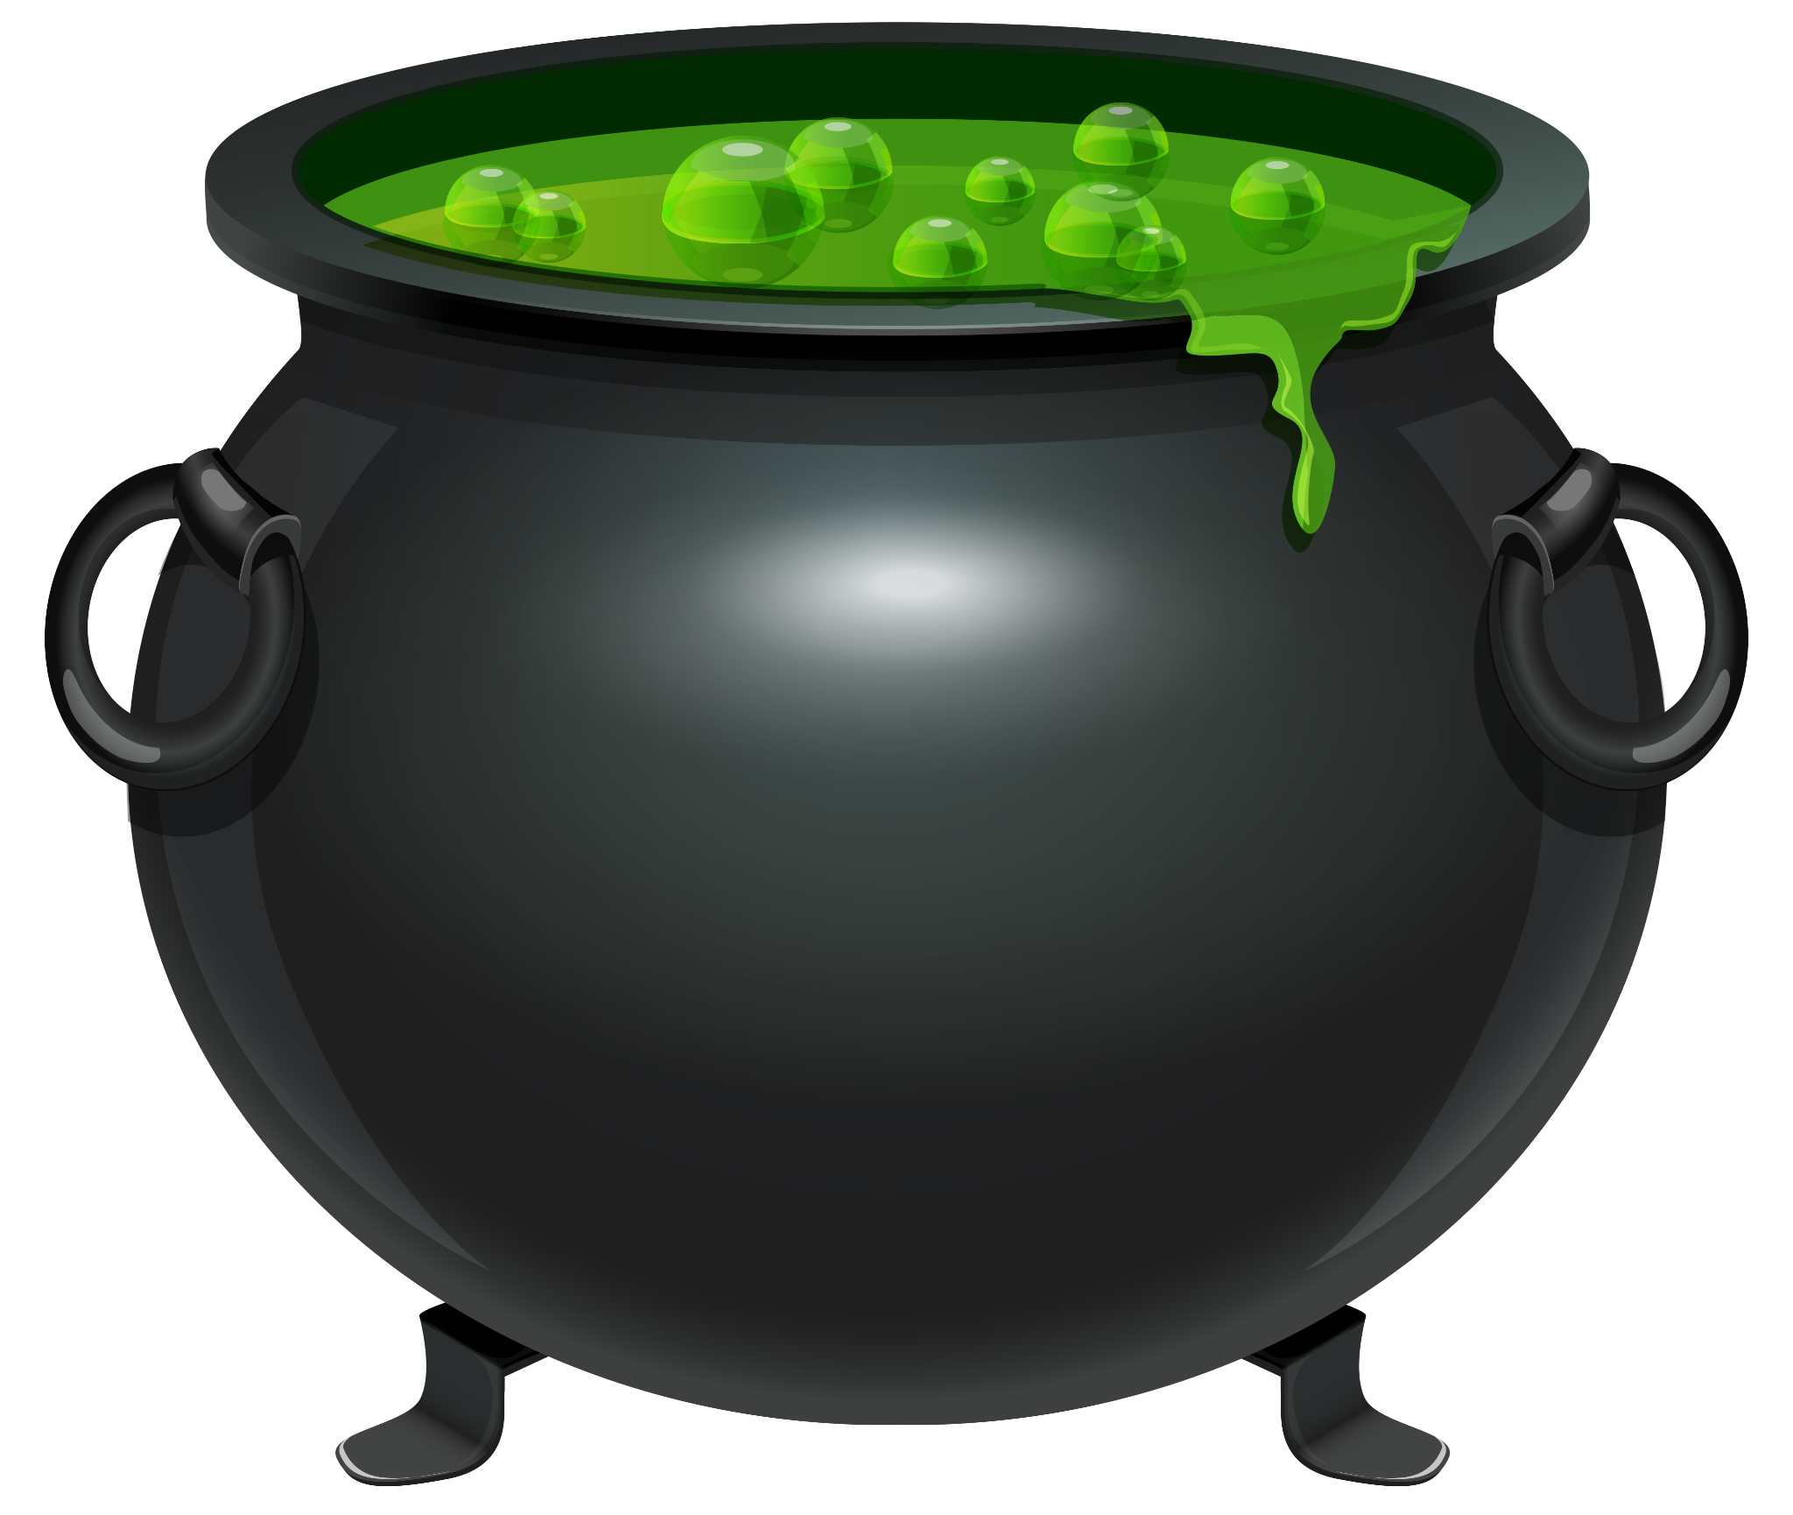
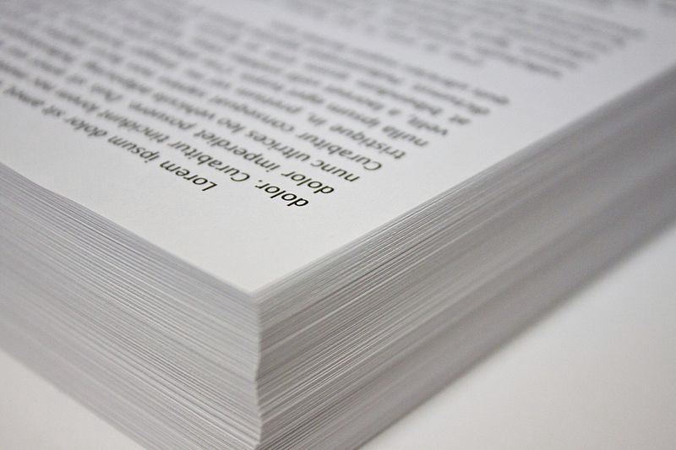
Ingredients of “research”
“Procedures” = computer code
“Materials (1)” = data
“Materials (2)” = computers

Slide 44
What does reproducibility NOT buy you?
Results in the paper are “right”
Replication package will work in two months time

Slide 45
Replication continuum
08
08
Reproducibility
Replicability
Narrow Replication (Pesaran 2003)
Pure Replication (Hamermesh 2007)
Verification (Clemens 2015)
Wide Replication (Pesaran 2003)
Statistical Replication (Hamermesh 2007)
Reproduction/Reanalysis (Clemens 2015)

Slide 46
Replication continuum
Same data | Different code | Same methods | Same context
 | or software
08
08
Reproducibility
Replicability
Narrow Replication (Pesaran 2003)
Pure Replication (Hamermesh 2007)
Verification (Clemens 2015)
Wide Replication (Pesaran 2003)
Statistical Replication (Hamermesh 2007)
Reproduction/Reanalysis (Clemens 2015)

Slide 47
Replication continuum
New data | Same code | Same methods | Same context
collection
08
08
Reproducibility
Replicability
Narrow Replication (Pesaran 2003)
Pure Replication (Hamermesh 2007)
Verification (Clemens 2015)
Wide Replication (Pesaran 2003)
Statistical Replication (Hamermesh 2007)
Reproduction/Reanalysis (Clemens 2015)

Slide 48
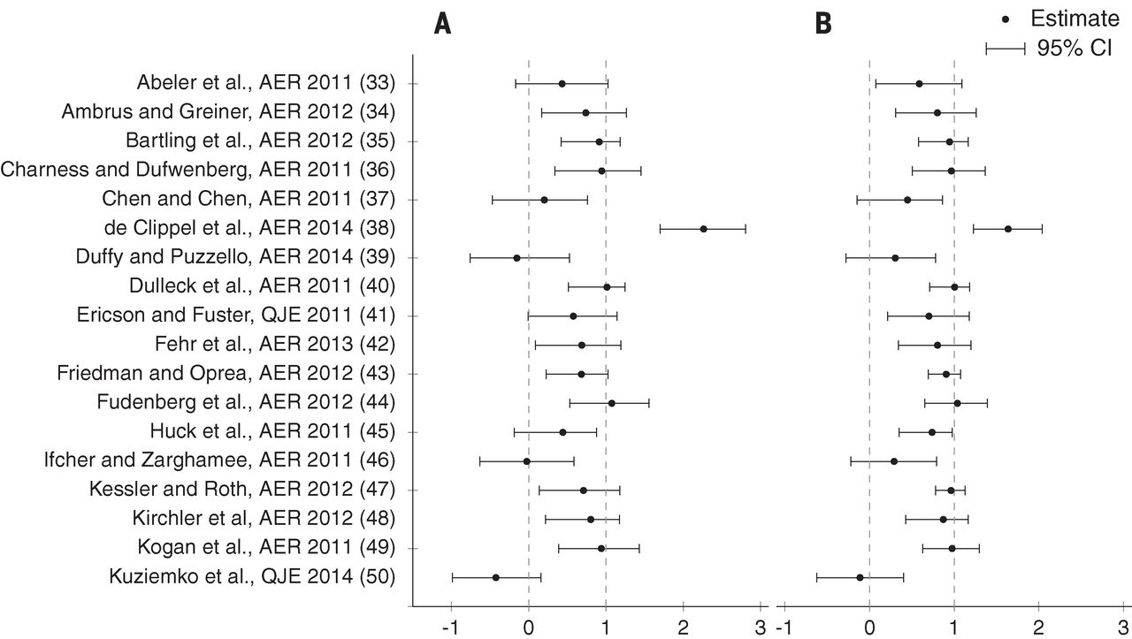
Replicability in Experimental Economics
Camerer et al. (2016)
Notes:
What does lack of replication look like/mean? It can mean that when replication is done, studies find different results.
Replicated 18 studies published in the American Economic Review and the Quarterly Journal of Economics between 2011 and 2014. All of these replications followed predefined analysis plans that were made publicly available beforehand. Found a significant effect in the same direction as in the original study for 11 replications (61%); on average, the replicated effect size is 66% of the original.
Inflated estimates: replications typically have far smaller estimated effects, often by half, Camerer et al (2016)
Replication results.(A) Plotted are 95% CIs of replication effect sizes (standardized to correlation coefficients). The standardized effect sizes are normalized so that 1 equals the original effect size (fig. S1 shows a nonnormalized version). Eleven replications have a significant effect in the same direction as in the original study
The 95% CI of the replication effect size includes the original effect size for 12 replications [66.7%; 95% CI = (42.5%, 90.8%)]; if we also include the study in which the entire 95% CI exceeds the original effect size, this increases to 13 replications [72.2%; 95% CI = (49.3%, 95.1%)].
(B) Meta-analytic estimates of effect sizes, combining the original and replication studies. Plotted are 95% CIs ofcombined effect sizes (standardized to correlation coefficients). The standardized effect sizes are normalized as in (A) (fig. S1 shows a nonnormalized version). Fourteen studies have a significant effect in the same direction as the original study in the meta-analysis

Slide 49
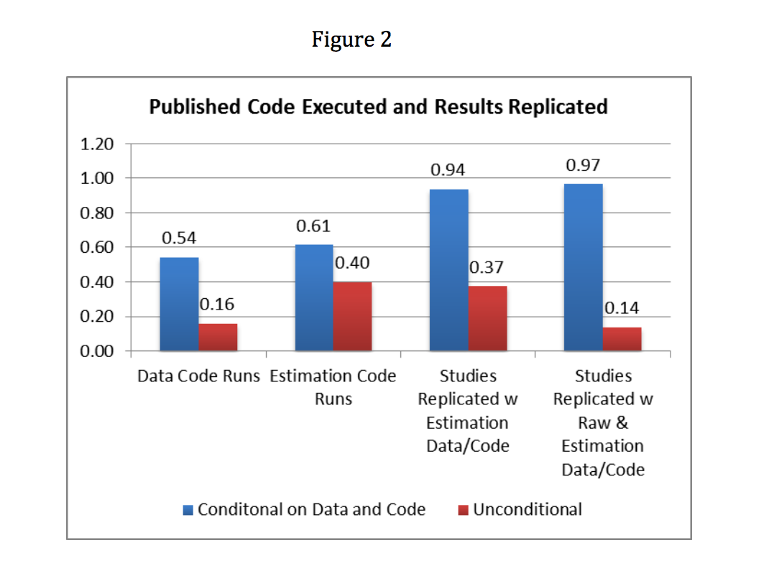
Galiani, Gertler, and Romero (2017)
Notes:
Poor replicability can also mean a first order problem – poor availability of data and code. And when it is available, it may not replicate.
Surveyed the last three issues as of May 2016 of nine leading economics journals. Among 203 article, found that only 76% of studies published at least one of the four files (raw data, data code, estimation data, estimation code).
Tried to replicate the tables and figures for the papers that posted data and code. Conditional on having the data and code available, only 54% of articles had “data manipulation code” that did not require major modifications (e.g., changing folder directories and installing additional packages) and only 61% of articles had “estimation code” that did not require major modifications.
In short, only 14% of the articles in sample of 203 were fully replicable (i.e. from raw data, to final tables and figures) and only 37% were partially replicable (i.e. from the estimation data to final tables and figures).

Slide 50
Replication continuum
08
08
08
Reproducibility
Replicability
Generalizability
Narrow Replication (Pesaran 2003)
Pure Replication (Hamermesh 2007)
Verification (Clemens 2015)
Wide Replication (Pesaran 2003)
Statistical Replication (Hamermesh 2007)
Reproduction/Reanalysis (Clemens 2015)
Wider Replication (Pesaran 2003)
Scientific Replication (Hamermesh 2007)
Reanalysis/Robustness (Clemens 2015)

Slide 51
Replication continuum
Different data | Different code | Different | Different
 | or software | methods | context or
 |  |  | country
08
08
08
Reproducibility
Replicability
Generalizability
Narrow Replication (Pesaran 2003)
Pure Replication (Hamermesh 2007)
Verification (Clemens 2015)
Wide Replication (Pesaran 2003)
Statistical Replication (Hamermesh 2007)
Reproduction/Reanalysis (Clemens 2015)
Wider Replication (Pesaran 2003)
Scientific Replication (Hamermesh 2007)
Reanalysis/Robustness (Clemens 2015)

Slide 52
What does reproducibility ALSO buy you?
It may be worth your while to start thinking about replicating or generalizing the results! (Plausibility)

Slide 53
A bit of background

Slide 54

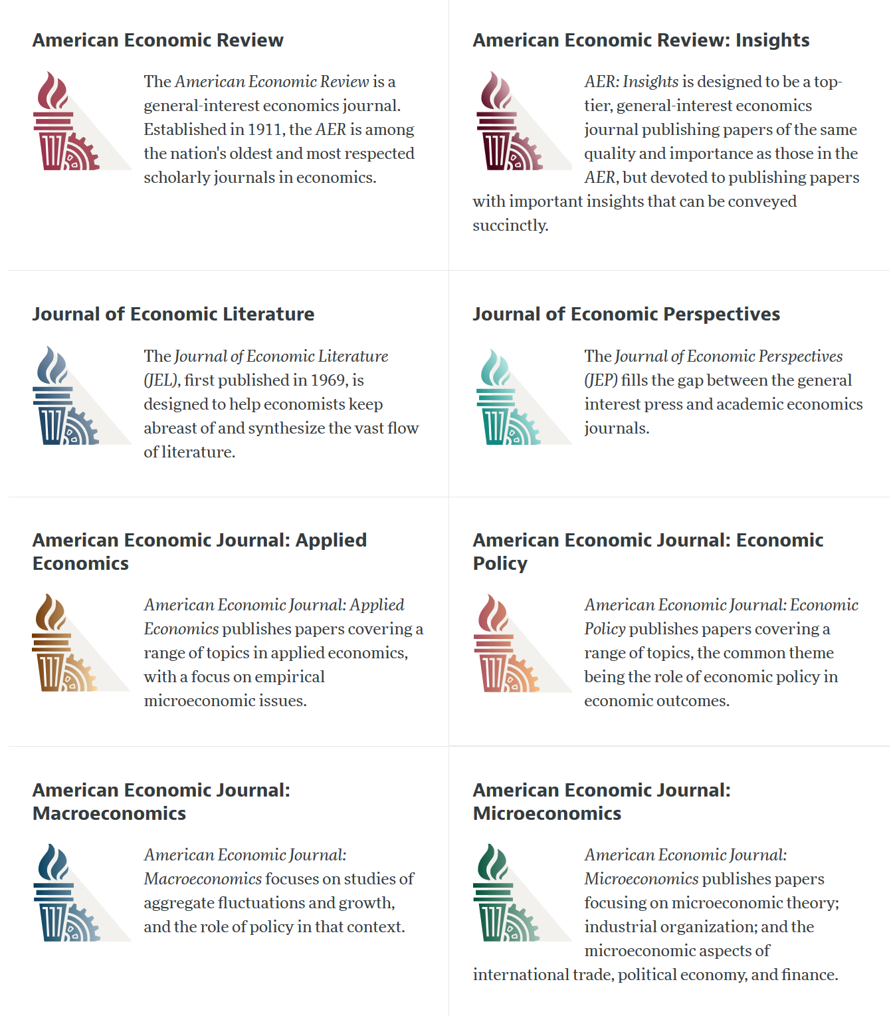

Slide 55
AEA Data & Code Availability Policy (2019)
It is the policy of the American Economic Association to publish papers only if the data used in the analysis are clearly and precisely documented and access to the data and code is clearly and precisely documented and is non-exclusive to the authors.
Authors of accepted papers that contain empirical work, simulations, or experimental work must provide, prior to acceptance, the data, programs, and other details of the computations sufficient to permit replication, as well as information about access to data and programs.

Slide 56
Current efforts at the AEA
Pre-emptively improve code archives
By conducting reproducibility checks when we can
By working with groups that conduct reproducibility checks when we cannot
Better archives
Greater transparency of the code and data archives
Better provenance tracking
Leave code where it is when appropriate
Leave data where it is almost always
Display that information
Notes:
Add logo from AEA

Slide 57
AEA Pre-Publication Verification
Every paper that receives a “conditional acceptance” is verified
Data citations
Quality of README
Quality of code
Reproducibility of code
Quality of metadata in the repository

Slide 58
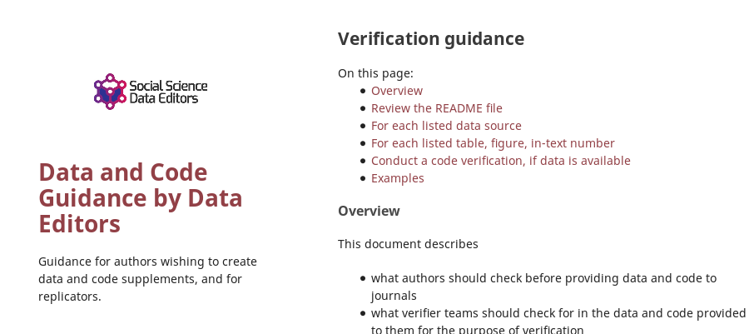

Action: Reproducibility Check

Slide 59
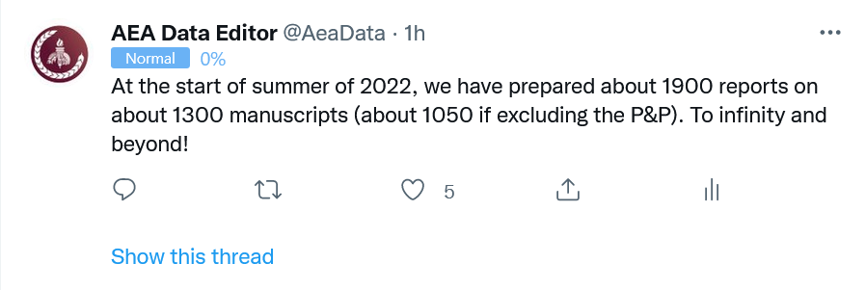
Stats on reproduced articles
Between July 16, 2019, and June 20, 2022, the AEA Data Editor team conducted
1900 assessments
for 1050 manuscripts (full papers)

Slide 60
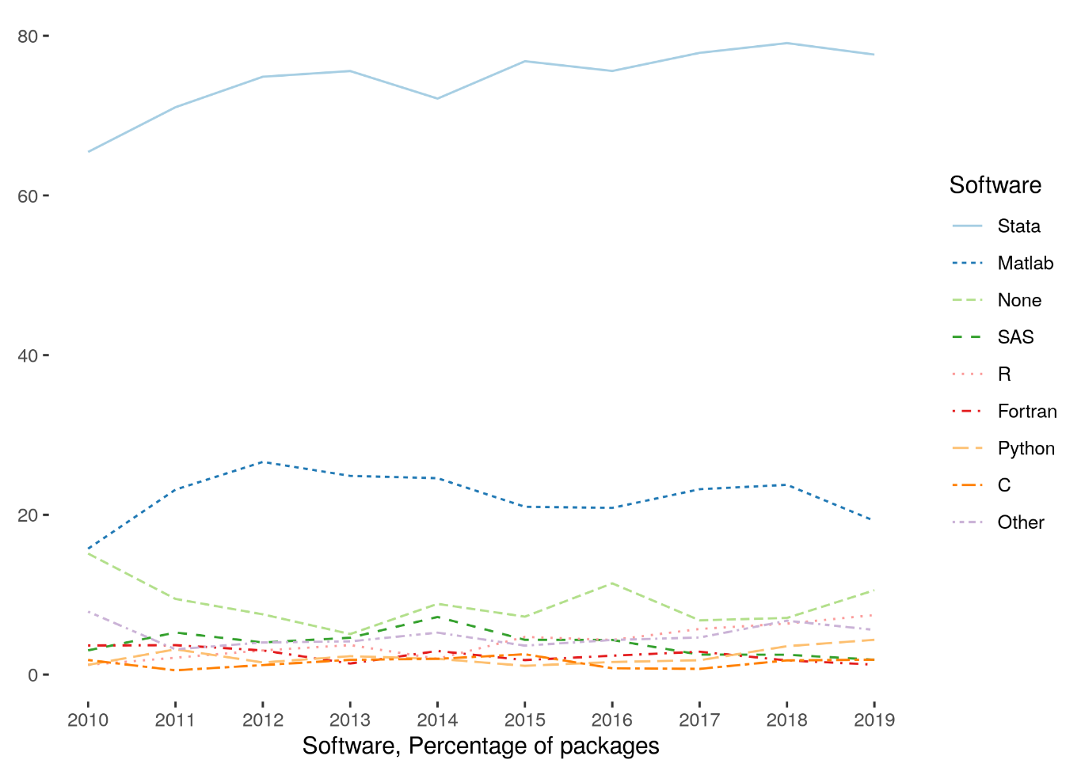
Very little diversity in software
Stata is the most popular statistical software in the journals of the AEA (72.96% of all supplements, 2010-2019)
followed by Matlab (22.45%)

Slide 61
Lessons?

Slide 62
Observation 0
Researchers don’t…
Re-run their code before submitting
Streamline (automate) enough
Carefully document data sources
Curate their own data

Slide 63
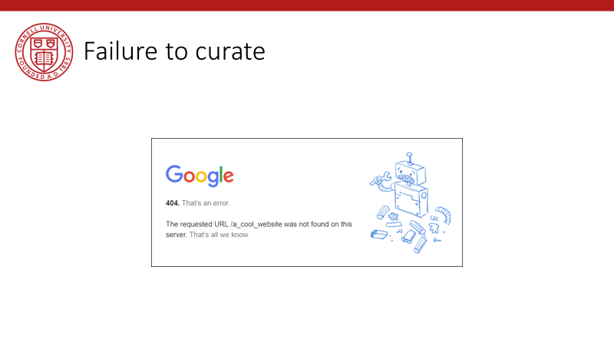
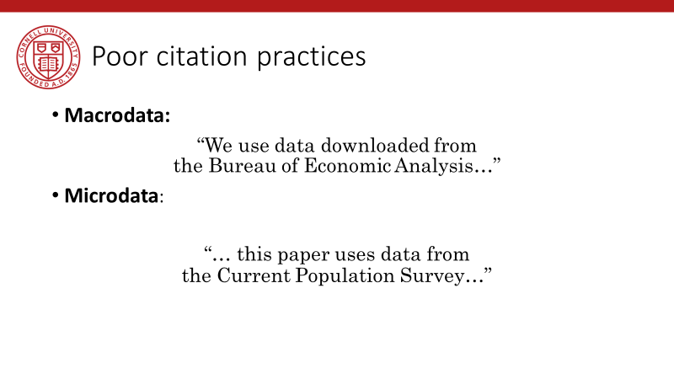
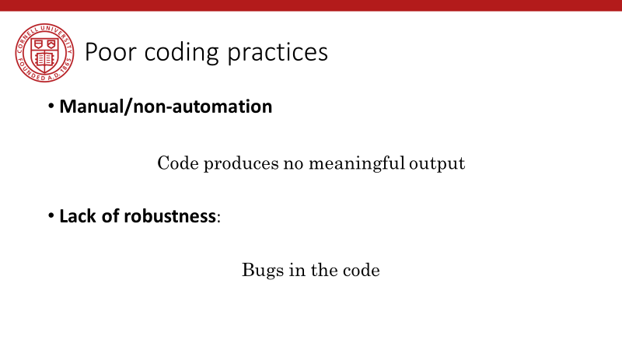
Back in 2019…

Slide 64
Lessons!

Slide 65
Observation 0
You should
Re-run your code before submitting
Streamline (automate) enough
Carefully document data sources
Curate your own data

Slide 66
Computational empathy

Slide 67
Lesson 1: Computational empathy
In the words of the slogan popularized by Buckheit and Donoho (1995),
“a scientific publication is [...] merely advertising of the scholarship: [...] the complete software development environment and the complete set of instructions which generated the figures.”

Slide 68
Lesson 1: Computational empathy
Put yourself in the position of the reader of the research compendium:
Can they understand those instructions?
Under what premises/ shared common knowledge?
What might they assume about the computing environment?
How concise or diffuse are the instructions?

Slide 69
Lesson 1: Computational empathy
Potential readers
You (in 4 years, between prepping 2 new courses, an R&R, a new child, and tenure coming up in 2 years)
Your RA (in 4 years, because you are… see above)
Your future readers who will cite you (in 4-10 years, who may want to extend or replicate your study, but won’t if it is too complex)

Slide 70
Lesson 1: Computational empathy
= “Pity the poor replicator”

Slide 71
Intermezzo

Slide 72
Observation 1
Social scientists do not read the manual
(beyond the first few pages)

Slide 73
Observation 1: Please read the manual
Persistent misconceptions
About setting working directories
How to record pathnames
How to leverage loops
How to leverage subroutines
How to pass parameters
How (and if) to use controller scripts

Slide 74
Observation 2
Social scientists love point-and-click interfaces (which are hard to reproduce)

Slide 75
Observation 2: point-and-click interfaces
This is reflected in
GIS (maps) that appear in papers
Data extraction tools
How to run software (any software)

Slide 76
Observation 1 and 2 are the result of a lack of Computational Empathy, and lead to high burden of reproducibility and replicability

Slide 77
Solutions?

Slide 78
Hold that thought, we will get there.

Slide 79
Data acumen

Slide 80
Data acumen
“the ability to understand data, to make good judgments about and good decisions with data, and to use data analysis tools responsibly and effectively”
National Academies of Sciences, Engineering, and Medicine. 2018. Data Science for Undergraduates: Opportunities and Options. Washington, DC: The National Academies Press. https://doi.org/10.17226/25104.

Slide 81
Lesson 2: Data acumen in the context of reproducibility
Two key components
Data provenance
Where did the data come from which I used?
Data preservation
Where do I put the data I generated?
What if the data I used are not “robustly preserved”?
What do you mean by that?

Slide 82
Data provenance

Slide 83
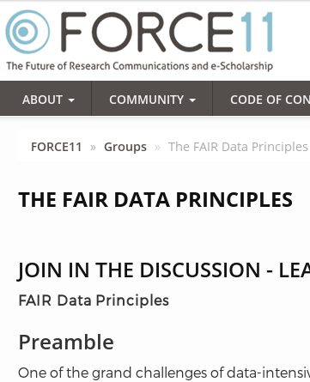
Action: Data citations and metadata
What is FAIR?
Findable,
Accessible,
Interoperable, and
Re-usable

Slide 84
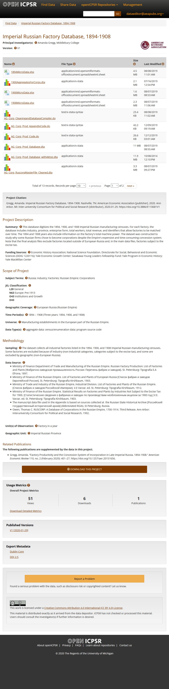
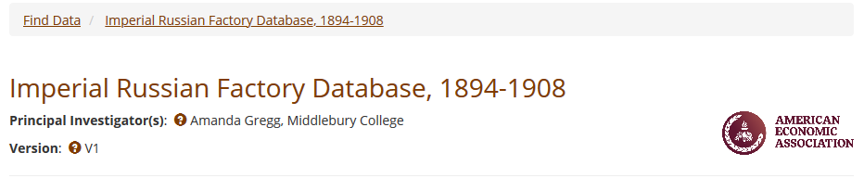
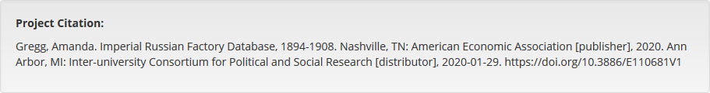
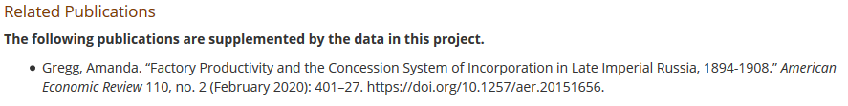

Slide 85
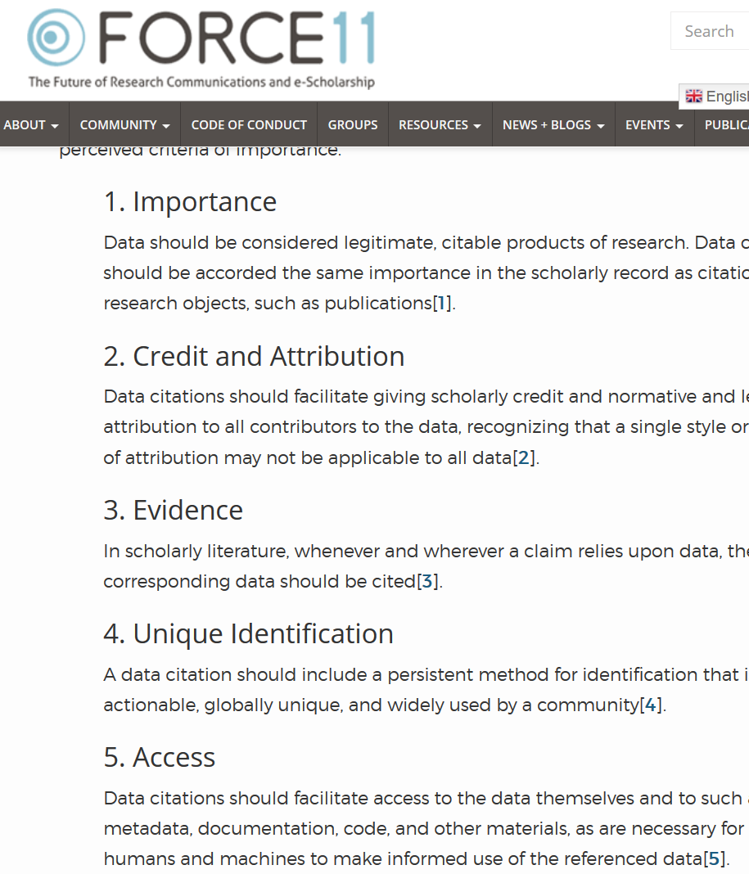

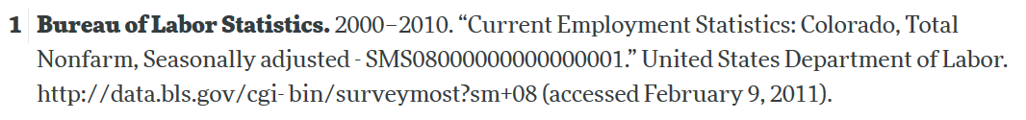
Starts with Data Citations
Data Citation Principles
Image of a standard data citation
Data Citation Synthesis Group: Joint Declaration of Data Citation Principles. Martone M. (ed.) San Diego CA: FORCE11; 2014 [https://www.force11.org/group/joint-declaration-data-citation-principles-final].

Slide 86
Observation 3
Social scientists are not trained to cite data

Slide 87

Would you buy a car from this guy?

Slide 88
Provenance!
Does the sales person have a good record?
Where does the car come from?
What do we know about the car?

Slide 89
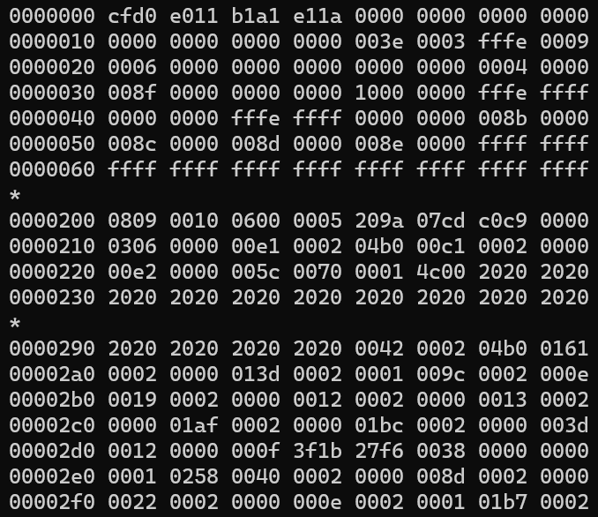
Would you use this data?

Slide 90
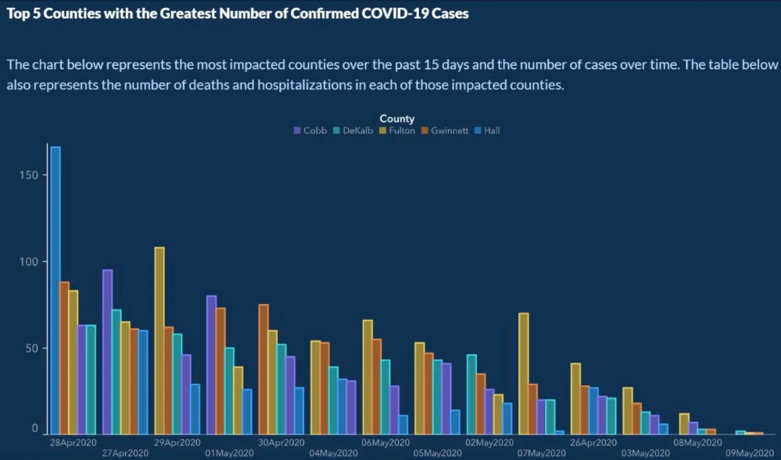
Or would you trust this data?

Slide 91
Provenance!
Does the provider have a good record?
Where do the data come from?
What do we know about the data?
Metadata!

Slide 92
Would you use this data?

Slide 93
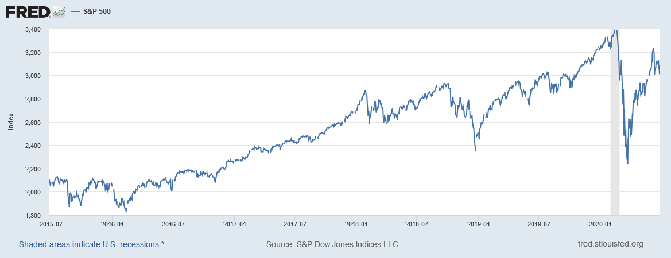
“It’s a file called stockmarket.xlsx”
2101.49
2057.64
2063.11
2077.42
2076.78
0
2068.76
2081.34
2046.68
2051.31
2076.62
2099.60
2108.95
2107.40
2124.29
2126.64
2128.28
2119.21
2114.15
2102.15
2079.65
2067.64
2093.25
2108.57
2108.63
2103.84

Slide 94
“It’s a file called SP500.xlsx”
SP500 | S&P 500, Index, Daily, Not Seasonally Adjusted
Frequency: Daily, Close
observation_date | SP500
2015-06-26 | 2101.49
2015-06-29 | 2057.64
2015-06-30 | 2063.11
2015-07-01 | 2077.42
2015-07-02 | 2076.78
2015-07-03 | 0
2015-07-06 | 2068.76
2015-07-07 | 2081.34
2015-07-08 | 2046.68
2015-07-09 | 2051.31
2015-07-10 | 2076.62
2015-07-13 | 2099.60
2015-07-14 | 2108.95
2015-07-15 | 2107.40
2015-07-16 | 2124.29
2015-07-17 | 2126.64
2015-07-20 | 2128.28

Slide 95
“It’s a file called SP500.xlsx, downloaded from FRED.”
SP500 | S&P 500, Index, Daily, Not Seasonally Adjusted
Frequency: Daily, Close
observation_date | SP500
2015-06-26 | 2101.49
2015-06-29 | 2057.64
2015-06-30 | 2063.11
2015-07-01 | 2077.42
2015-07-02 | 2076.78
2015-07-03 | 0
2015-07-06 | 2068.76
2015-07-07 | 2081.34
2015-07-08 | 2046.68
2015-07-09 | 2051.31
2015-07-10 | 2076.62
2015-07-13 | 2099.60
2015-07-14 | 2108.95
2015-07-15 | 2107.40
2015-07-16 | 2124.29
2015-07-17 | 2126.64
2015-07-20 | 2128.28

Slide 96
“It’s a file called SP500.xlsx, downloaded from FRED.”
S&P Dow Jones Indices LLC. 2020. “S&P 500 [SP500] [dataset]”, retrieved from FRED, Federal Reserve Bank of St. Louis; https://fred.stlouisfed.org/series/SP500, June 26, 2020.
SP500 | S&P 500, Index, Daily, Not Seasonally Adjusted
Frequency: Daily, Close
observation_date | SP500
2015-06-26 | 2101.49
2015-06-29 | 2057.64
2015-06-30 | 2063.11
2015-07-01 | 2077.42
2015-07-02 | 2076.78
2015-07-03 | 0
2015-07-06 | 2068.76
2015-07-07 | 2081.34
2015-07-08 | 2046.68
2015-07-09 | 2051.31
2015-07-10 | 2076.62
2015-07-13 | 2099.60
2015-07-14 | 2108.95
2015-07-15 | 2107.40
2015-07-16 | 2124.29
2015-07-17 | 2126.64
2015-07-20 | 2128.28

Slide 97
“SP500.xlsx, from S&P (2020). Not provided as part of replication package because © S&P. ”
S&P Dow Jones Indices LLC. 2020. “S&P 500 [SP500] [dataset]”, retrieved from FRED, Federal Reserve Bank of St. Louis; https://fred.stlouisfed.org/series/SP500, June 26, 2020.
SP500 | S&P 500, Index, Daily, Not Seasonally Adjusted
Frequency: Daily, Close
observation_date | SP500
2015-06-26 | 2101.49
2015-06-29 | 2057.64
2015-06-30 | 2063.11
2015-07-01 | 2077.42
2015-07-02 | 2076.78
2015-07-03 | 0
2015-07-06 | 2068.76
2015-07-07 | 2081.34
2015-07-08 | 2046.68
2015-07-09 | 2051.31
2015-07-10 | 2076.62
2015-07-13 | 2099.60
2015-07-14 | 2108.95
2015-07-15 | 2107.40
2015-07-16 | 2124.29
2015-07-17 | 2126.64
2015-07-20 | 2128.28

Slide 98
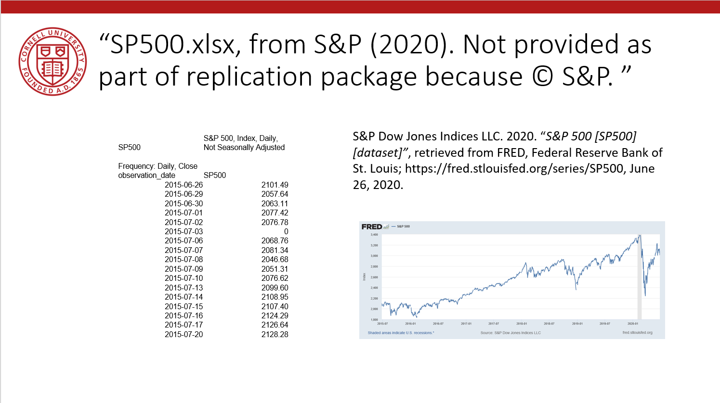
Data Availability Statements
Describes data file, where to get it, how to get it, and any conditions of obtaining it

Slide 99
Data Citation
Attributes the file to the proper source

Slide 100
J-PAL and IPA Data Publication Policy
 | J-PAL | IPA
Date Adopted | June 2015 | February 2015
Who? | J-PAL Initiative-funded research projects | All IPA-implemented, IPA initiative-funded research projects
When? | Between 18 months and 5 years after the completion of final data collection. | Three years following the completion of final data collection.
What? | All primary data (not just those used for the analysis), with opt-out option | Accepts three tiers of data publication
Where? | A trusted data repository (either Dataverse or elsewhere) | IPA or J-PAL Dataverse
J-PAL Policy: https://www.povertyactionlab.org/research-resources/transparency-and-reproducibility
IPA Policy: https://www.poverty-action.org/sites/default/files/guidelines_for_data_publication_final.pdf
Notes:
Note: You should DEPOSIT the data as soon as possible – don’t wait that long! Pulling the trigger (publishing) can happen later!

Slide 101
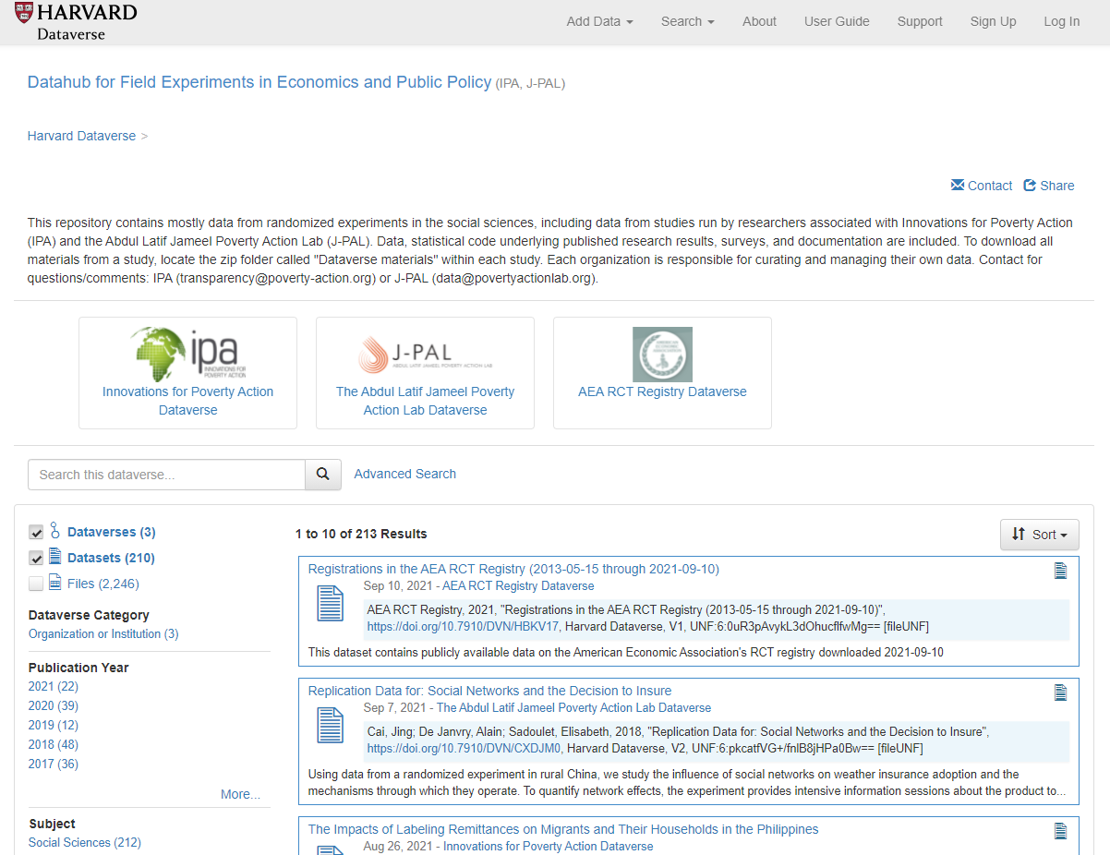
Datahub for Field Experiments in Economics and Public Policy
Notes:
Launched in 2019; umbrella for J-PAL and IPA dataverses. Note Registry dataverse as well
2013 currently

Slide 102
A note
You will still hear a lot about “data publication” or “data availability policy”
It always means “… and code…”!!!

Slide 103
But:
Data publication and code publication may not happen at the same time!
Treat your use of original survey data as the first re-use of the data
Data publication and code publication may not use the same tools
Github is a great place for code during the lifetime of a project – not for data!
Dataverse is a great place for data during and after the lifetime of a project, but it really isn’t that great for code!
There is a value in having self-contained and complete “replication packages”
There is also value in having the best tool for each purpose

Slide 104
Reminder: Students and Researchers
Computational empathy Consider the next person to run the analysis, and don’t assume too much
Track data even when using API, especially when manually downloading, keep in mind what the next downloader may see/find/receive, terms of use
Learn the basics of programming code reproducibly, use parameter files, re-usable code, robust file structure
Learn to automate Run all code again and again, use APIs to download, use conditional processing to handle various aspects
Preserve it all Use version control, tag releases, preserve data (separately), understand the difference between sharing and preserving

Slide 105
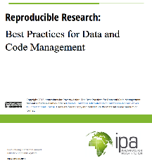
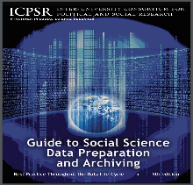
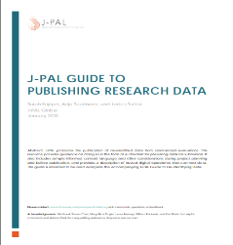
IPA best practices on data and code management
ICPSR guides to publishing data
J-PAL guide to de-identifying research data

Slide 106
J-PAL and IPA Resources for Transparency
J-PAL Website, Information for Affiliates
J-PAL Website, Transparency & Reproducibility
J-PAL Salesforce Chatter Group, Research Chatter
Email us! Data@povertyactionlab.org
J-PAL Research Resources
Trial Registration
Pre-Analysis Plans
Data De-identification
Data publication
IPA Website, Research Transparency
IPA Salesforce Chatter Group, Research Transparency

Slide 107
Other Resources on Research Transparency
Anderson, et. al. 2007. “Normative Dissonance in Science: Results from a National Survey of U.S. Scientists”
Ben Olken, “The Promises and Perils of Pre-Analysis Plans”, http://economics.mit.edu/files/10654
Berkeley Institute for Transparency in the Social Sciences (BITSS), www.bitss.org
BITSS, “The Problems of Publication Bias and P-Hacking, and the Potential Solution of Pre-registration”, https://www.youtube.com/watch?v=y8Ti5uOfkUk
Christensen, Garret, Jeremy Freese, and Edward Miguel. Transparent and reproducible social science research: How to do open science. University of California Press, 2019.
Duflo, Esther et al. ”In Praise of Moderation: Suggestions for the Scope and Use of Pre-Analysis Plans for Rcts in Economics” (April 2020). NBER Working Paper No. w26993, Available at SSRN: https://ssrn.com/abstract=3580551
FiveThirtyEight, “Hack Your Way to Scientific Glory”, http://projects.fivethirtyeight.com/p-hacking/
John Oliver, “Scientific Studies,” https://youtu.be/0Rnq1NpHdmw
Michael Clemens, 2015. “The Meaning of Failed Replications: A Review and Proposal,” http://ftp.iza.org/dp9000.pdf

Slide 108
Credits
I liberally re-used slides from a previous J-PAL-only presentation
Various J-PAL and IPA staff have contributed to this presentation over the years, including: Sarah Kopper (J-PAL), Anja Sautmann (J-PAL), James Turrito (J-PAL), Stephanie Wykstra (IPA), Laura Feeney (J-PAL), Marc Shotland (J-PAL), and Hasina Badani (IPA).

Slide 110
Some practical tips
(based on 1000 articles)
(if we have time)

Slide 111
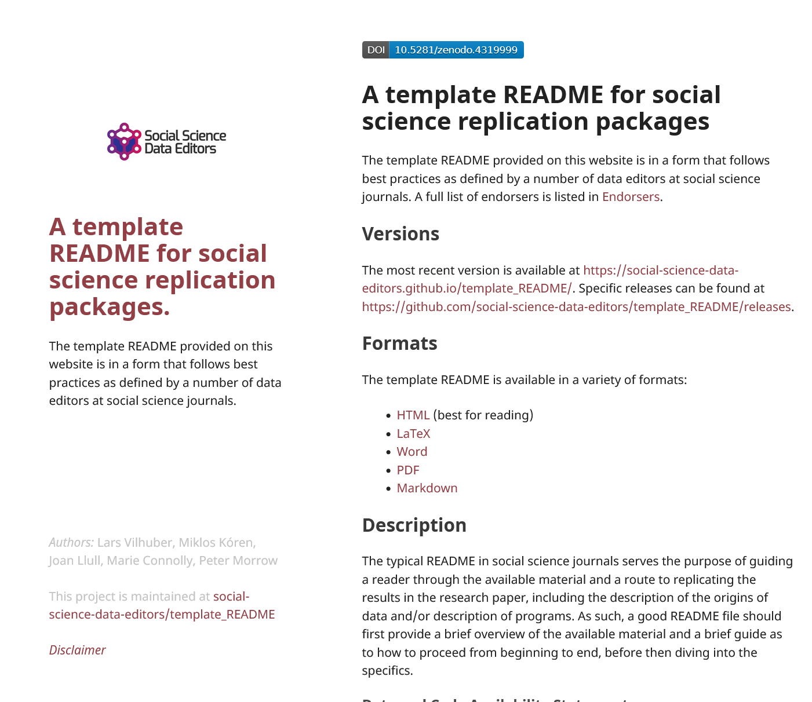
1. Computational empathy
Focal reader: your next RA in 4 years
Interaction: you hand them your README, but don’t have time to go through all the details…
Budget constraint: It shouldn’t take too many RA hours
Time constraint: It shouldn’t take more than 1 week to “get it”

Slide 112
Solution 1: Computational Empathy
Use the Social Science Data Editors’ template README https://doi.org/10.5281/zenodo.4319999

Slide 113
Keeping track: Students and Researchers
Computational empathy Consider the next person to run the analysis, and don’t assume too much

Slide 114
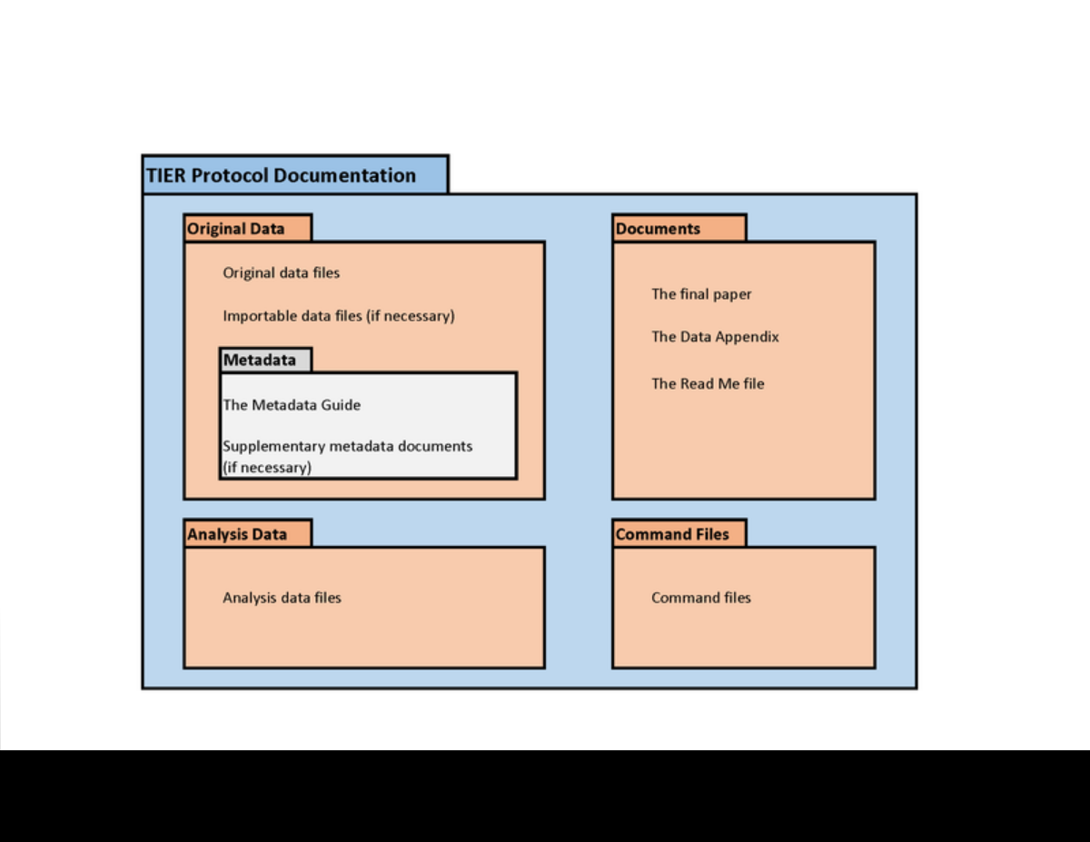
2. Keeping track of data: Data provenance
Keep all information as you collect data
See TIER Protocol for good and simple guidance
If you must use a point-and-click tool, keep detailed instructions
Also: obsolescence
Try to use API, bulk download, or packages that allow for extraction
Also: obsolescence of API

Slide 115
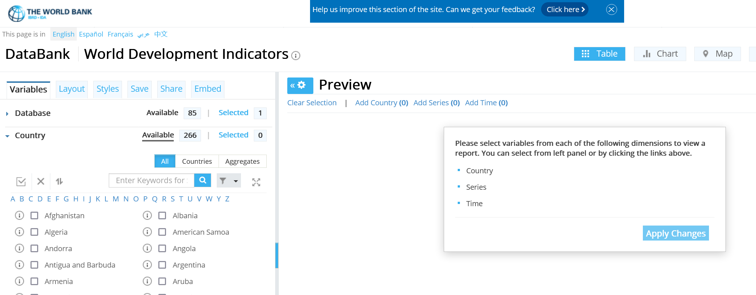
API? But the interface is so cool!
World Development Indicators

Slide 116
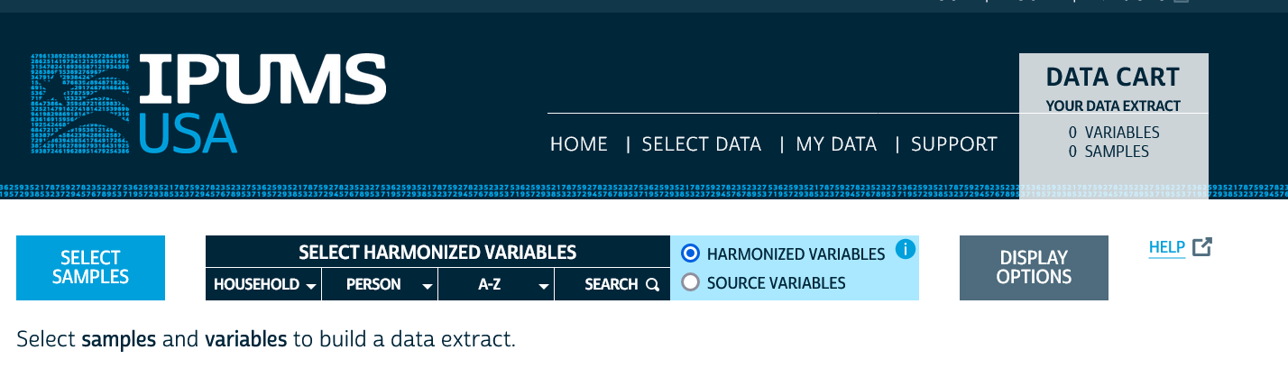
API? But the interface is so cool!
IPUMS

Slide 117
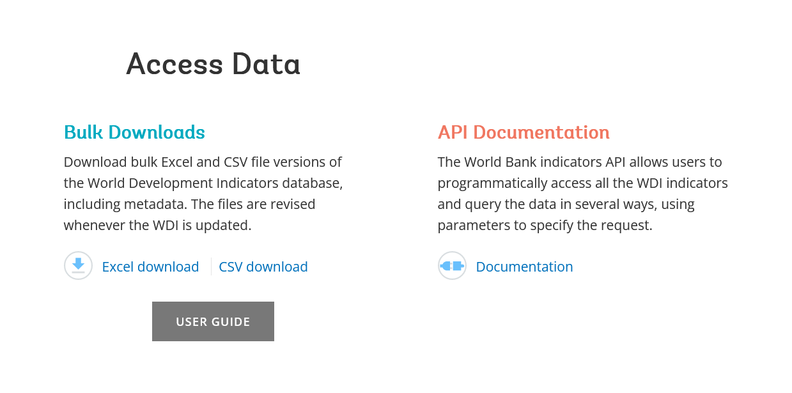
API or Bulk Download
World Development Indicators

Slide 118
API or Bulk Download
World Development Indicators
. ssc install wbopendata
. wbopendata, country(ago;bdi;chi;dnk;esp) indicator(sp.pop.0610.fe.un) /// > year(2000:2010) clear long

Slide 119
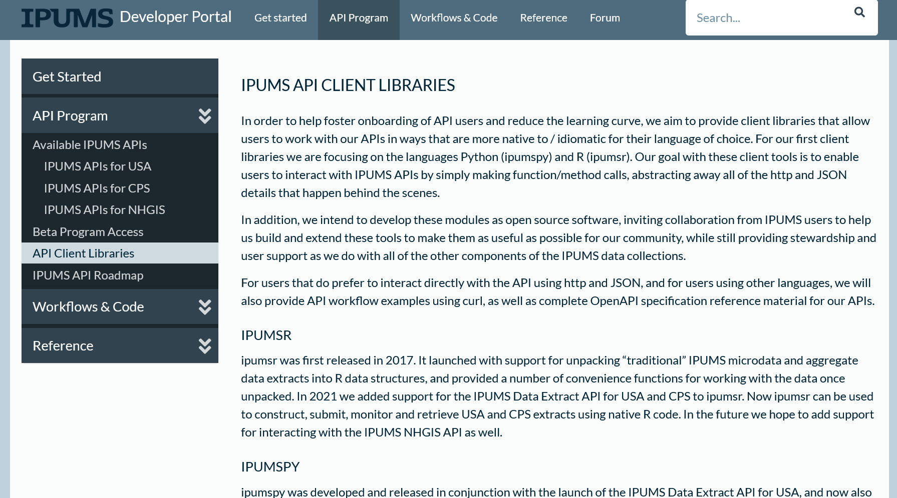
API or Bulk Download
IPUMS (beta)

Slide 120
2. Keeping track of data:
Don’t forget to check the TERMS of USE!

Slide 121
Observation 4
(Academic) Social scientists do not read the terms of use

Slide 122
Because you may not be able to provide others with a copy of the data (legally)…

Slide 123
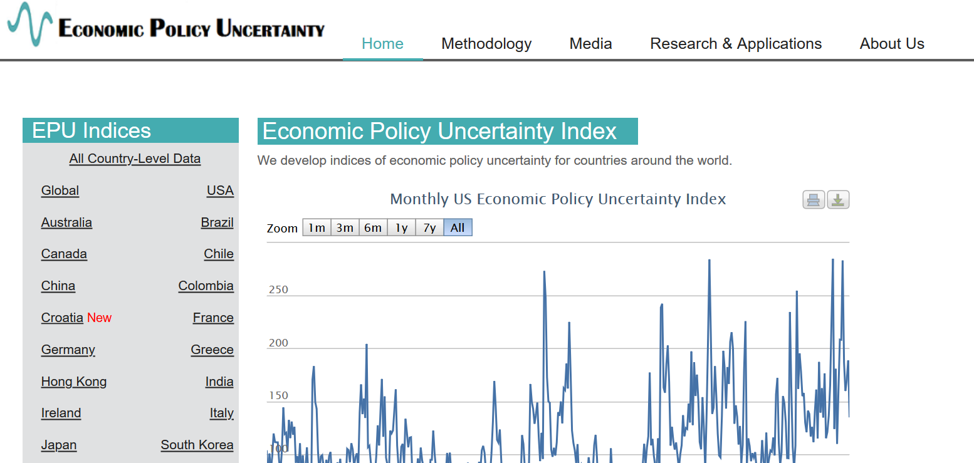
Example 2: Academic data publisher

Slide 124

Example 2: Academic data publisher

Slide 125

Example 2: Academic data publisher-new!

Slide 126
Rights to use data
You browsed a website
You purchased the data
You signed a data use agreement
You created the data (lab experiment)
You had survey respondents consent to use (IRB approval!)

Slide 127
Rights to distribute the data
If you created the data, you decide.
If you got it from somewhere else:
READ THE TERMS OF USE / DATA USE AGREEMENT / CLICK-THROUGH / ETC.

Slide 128
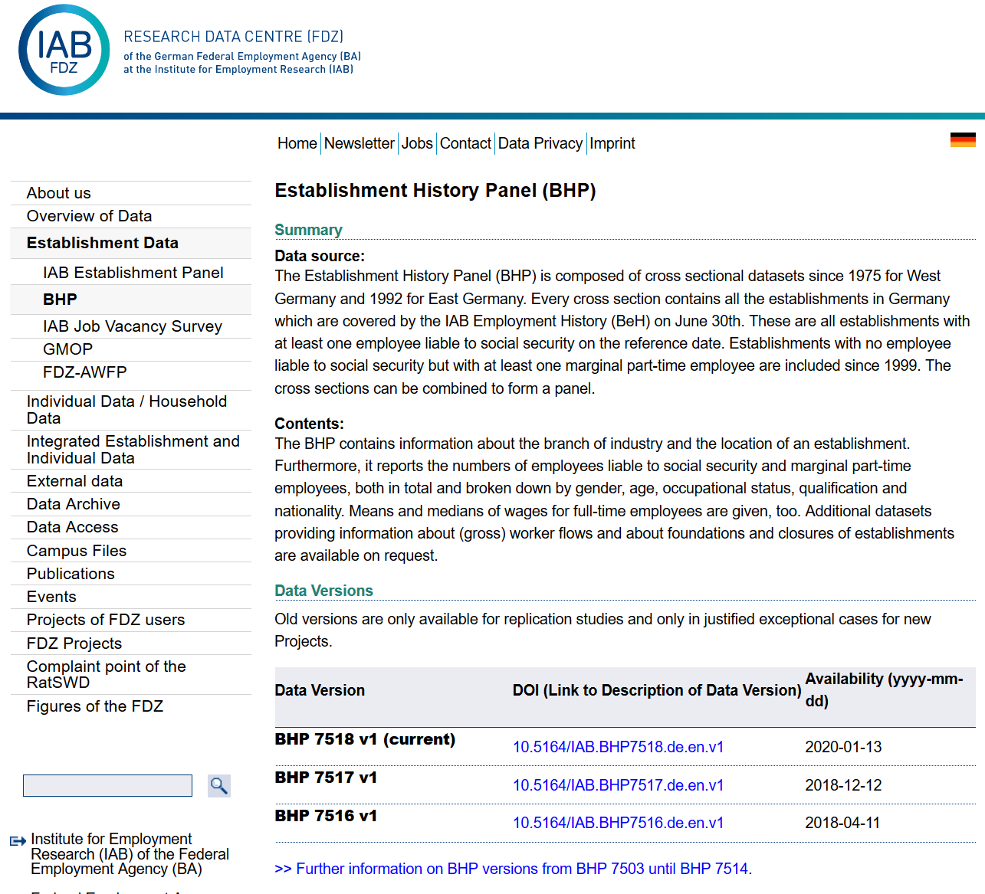
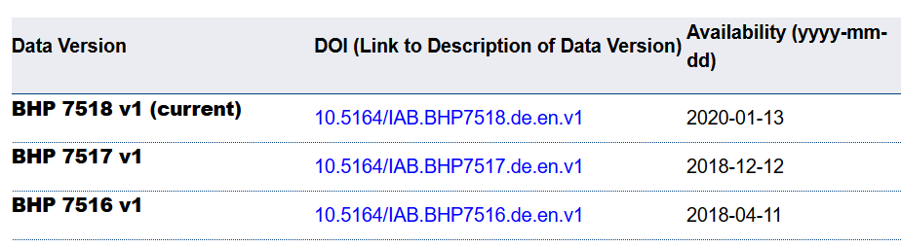
Example 4: German Restricted-access

Slide 129

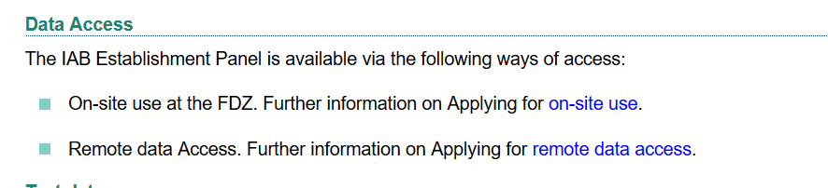
Example 4: German Restricted-access

Slide 130
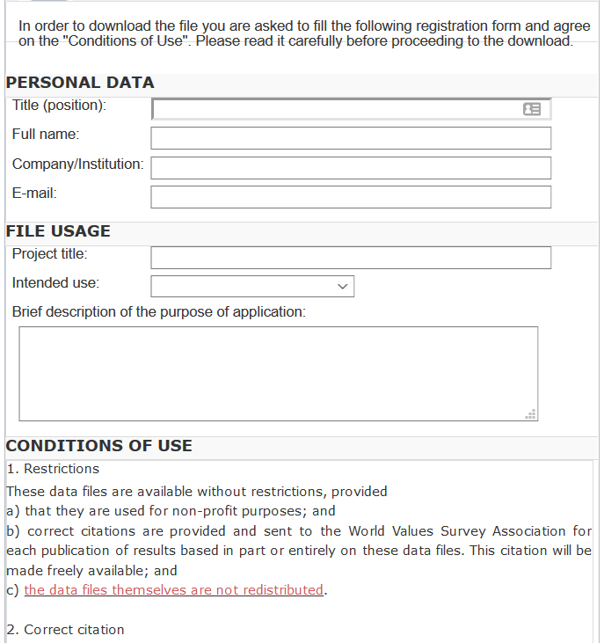
And we check them!
What does the site say?
Please use the following citation when referring to this file in the different versions: Inglehart, R., C. Haerpfer, A. Moreno, C. Welzel, K. Kizilova, J. Diez-Medrano, M. Lagos, P. Norris, E. Ponarin & B. Puranen et al. (eds.). 2014. World Values Survey: Round Six - Country-Pooled Datafile Version: www.worldvaluessurvey.org/WVSDocumentationWV6.jsp. Madrid: JD Systems Institute.
Is that in the README / Paper/ Appendix?
Are all the conditions met/described?

Slide 131
Solution 2: Data Provenance
Keep detailed notes
script as much as possible
(also: Use the Social Science Data Editors’ template README)

Slide 132
Keeping track: Students and Researchers
Computational empathy Consider the next person to run the analysis, and don’t assume too much
Track data (provenance) even when using API, especially when manually downloading, keep in mind what the next downloader may see/find/receive, terms of use

Slide 133
Coding for Reproducibility

Slide 134
Lesson 1: Computational empathy
= “Pity the poor replicator”

Slide 135

Streamlining replication packages
Master script preferred
Least amount of manual effort
No manual manipulation
“Change the parameter to 0.2, then run the code again”
No manual copying of results
Write out/save tables and figures using packages
Compute all numbers in package
No manual install of packages
Use a script to create all directories, install all necessary packages/requirements/etc.
Clear instructions!

Slide 136
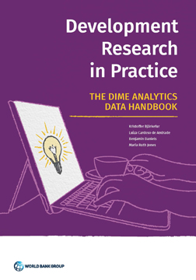
But I don’t need to tell you that
DIME Wiki, Handbook, this course!
https://www.worldbank.org/en/research/dime/data-and-analytics

Slide 137
Assume replicators can access the data
Sometimes we (=AEA) cannot
We will still check if the code seems complete
We will still verify that all data that *can* be provided have been provided
Plausibility checks
Sometimes we can:
In the past, we have worked with
French, Brazilian, and US confidential admin data
Purchased commercial data (Twitter, Indian GDP)
Proprietary data under NDA/DUA (Ebay)
Data with application procedure (Chinese Panel, Demographic and Health Survey, European establishment data)
Remotely or locally

Slide 138
Solution 3: Learn basics of programming
Code reproducibly
(and do so right from the start)
(also: way easier to describe in the Social Science Data Editors’ template README)

Slide 139
Keeping track: Students and Researchers
Computational empathy Consider the next person to run the analysis, and don’t assume too much
Track data even when using API, especially when manually downloading, keep in mind what the next downloader may see/find/receive, terms of use
Learn the basics of programming code reproducibly, use parameter files, re-usable code, robust file structure

Slide 140
We stop here for questions!

Slide 141
Keeping track: Students and Researchers
Computational empathy Consider the next person to run the analysis, and don’t assume too much
Track data even when using API, especially when manually downloading, keep in mind what the next downloader may see/find/receive, terms of use
Learn the basics of programming code reproducibly, use parameter files, re-usable code, robust file structure
Learn to automate Run all code again and again, use APIs to download, use conditional processing to handle various aspects
Preserve it all Use version control, tag releases, preserve data (separately), understand the difference between sharing and preserving

Slide 142
Support by Institutions

Slide 143
The rest of the day is spent discussing how the World Bank supports researchers. For a more general discussion, see other versions of this talk.

Slide 144

Luckily, you have DIME

Slide 145
Solution 6: Institutional support
(departments, schools, libraries, IT, universities)
Offer training in adapted tools (not sufficient to just show how to do a Rmarkdown document)
Highlight appropriate community (Zenodo, Dataverse, others) or university sites
Provide streamlined access to some frequently used (open/commercial) tools (AWS/GCS/Azure, CI on Github/others, etc.)

Slide 146

Please don’t produce irreproducible articles!

Slide 147
The role for journals

Slide 148
Goal: Transportability
Any standards, tools, methods: must be transportable across journals (no custom solutions)

Slide 149



Social science “guild”
https:// social-science -data-editors. github.io/ guidance/

Slide 150


Some resources
https://social-science-data-editors.github.io/guidance/
template README
discussion of licensing
data citation guidance
https://aeadataeditor.github.io/

Slide 151
Thank you!

Slide 152
Reminder: Students and Researchers
Computational empathy Consider the next person to run the analysis, and don’t assume too much
Track data even when using API, especially when manually downloading, keep in mind what the next downloader may see/find/receive, terms of use
Learn the basics of programming code reproducibly, use parameter files, re-usable code, robust file structure
Learn to automate Run all code again and again, use APIs to download, use conditional processing to handle various aspects
Preserve it all Use version control, tag releases, preserve data (separately), understand the difference between sharing and preserving

Slide 154
Extra slides (not presented)

Slide 155
Data Citations

Slide 156

Data citations
Creating specific guidance in the absence of strong discipline-specific guidance
https://social-science-data-editors.github.io/guidance/addtl-data-citation-guidance.html

Slide 157
Example 4: German Restricted-access

Slide 158
Data Citation
Attributes the file to the proper source

Slide 159
Element of a (data) citation
ICPSR notes that a citation should include the following items:
Author
Title
Distributor
Date
Version
Persistent identifier
Suggested Citation:
S&P Dow Jones Indices LLC, S&P 500 [SP500], retrieved from FRED, Federal Reserve Bank of St. Louis; https://fred.stlouisfed.org/series/SP500, June 26, 2020.

Slide 160
Element of a (data) citation
ICPSR notes that a citation should include the following items:
Author
Title
Distributor
Date
Version
Persistent identifier
Constructed Citation:
Institute for Employment Research (IAB), Establishment History Panel 1975-2018. Accessed via the Research Data Centre (FDZ) of the German Federal Employment Agency DOI: 10.5164/IAB.BHP7518.de.en.v1 June 26, 2020.

Slide 161
Element of a (data) citation
ICPSR notes that a citation should include the following items:
Author
Title
Distributor
Date
Version
Persistent identifier
Constructed Citation:
US Census Bureau, Longitudinal Business Database (LBD) 1975-2018. Last accessed via the Federal Statistical Research Data Centre (FSRDC) June 26, 2020.

Slide 162

Try it out yourself
Construct an (approximate) data citation
https://social-science-data-editors.github.io/guidance/addtl-data-citation-guidance.html#try-it-out

Slide 163
Data: Citations, Access, Rights
Any data can be cited – even if you can’t download it
Any data that you accessed … can have that access be described
But caution: It should be such that others can also repeat the access!
Just because you “have” the data does not mean you can give it to others
Also: distinguish between “sharing” and “publishing”
Know your terms of use!

Slide 164


Provide data citations (in manuscript) and data availability statements (in README or appendix)

Slide 165
Solution 3: Data Citations
Cite every data source
(not only the paper that describes the source!)
(also: add them to the Social Science Data Editors’ template README)

